Slide 1
802.11 PHYSICAL LAYER
G. Naresh

Slide 2
CONTENTS
Digital Modulation Techniques
FHSS PHY
DSSS PHY
HR - DSSS PHY
OFDM PHY
HT PHY
2.4 GHz Channels
5 GHz Channels

Slide 3
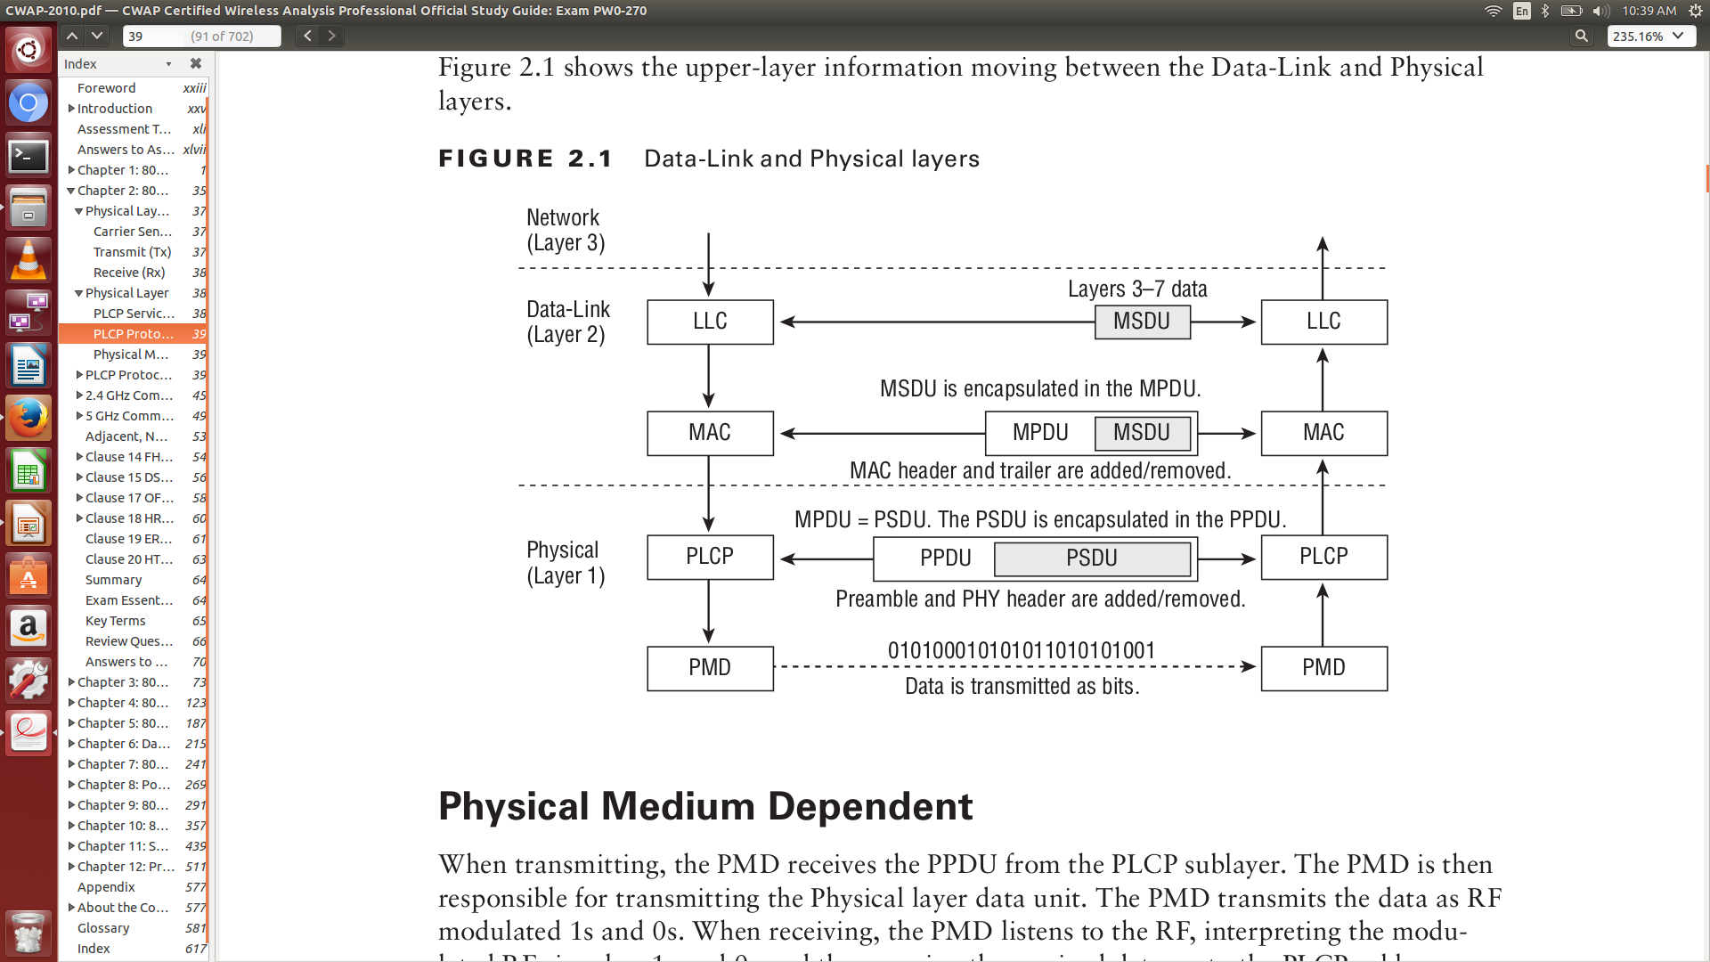
Physical layer

Slide 4
MODULATION
Modulation is the process of varying one or more properties of a periodic waveform, called the carrier signal, with a modulating signal that typically contains information to be transmitted.
Need for Modulation:
  To reduce the antenna height
  For multiplexing of signals
  To reduce noise and interference
Types of Modulation:
  Analog modulation
  Digital Modulation

Slide 5
Digital Modulation Techniques
ASK
FSK(BFSK)
PSK(BPSK)
QPSK

Slide 6
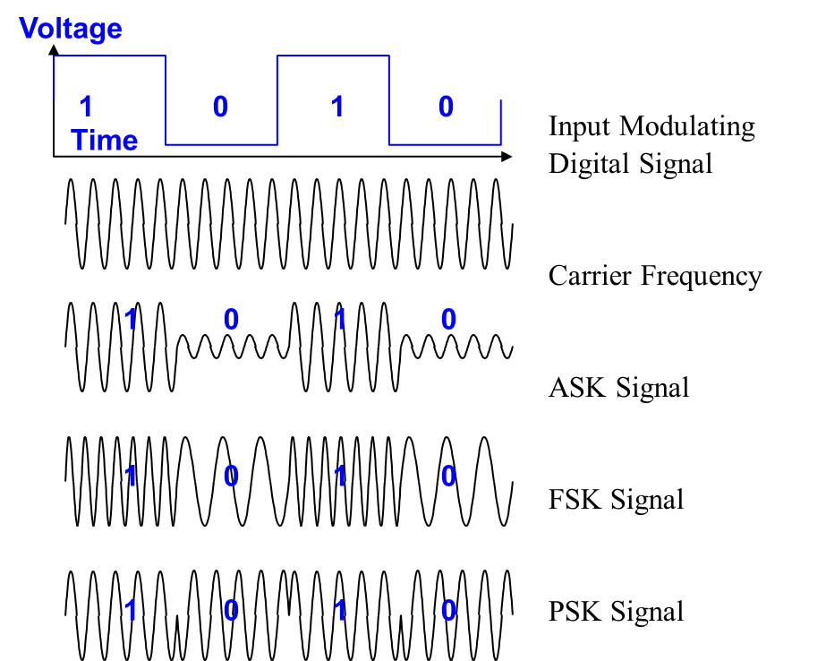
Digital Modulation Techniques

Slide 7
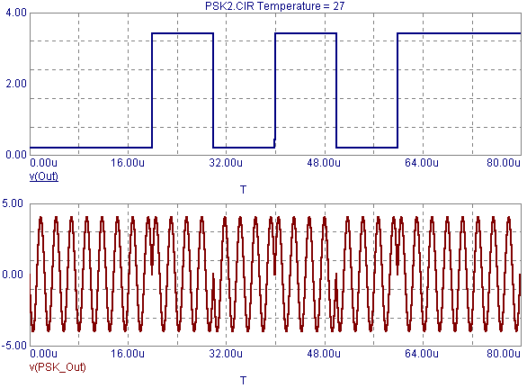
BPSK
The bit rate is equal to the baud rate (symbol rate).

Slide 8
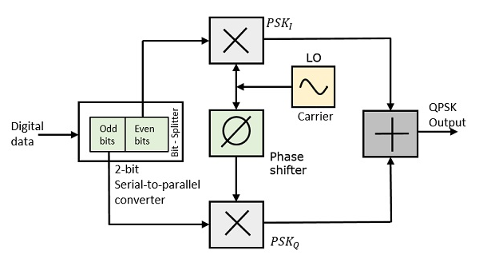
QPSK
QPSK is a form of Phase Shift Keying in which two bits are modulated at once, selecting one of four possible carrier phase shifts (0, 90, 180, or 270 degrees) .
QPSK allows the signal to carry twice as much information as ordinary PSK using the same bandwidth.
The bit rate is two times the baud rate (symbol rate).

Slide 9
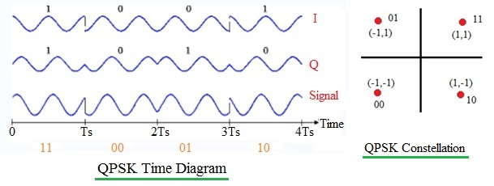
QPSK

Slide 10
802.11 FHSS PHY
Frequency hopping spread spectrum (FHSS) was used in the original 802.11 (Legacy) standard.
FHSS provides 1 and 2 Mbps RF communications using the 2.4 GHz ISM band for legacy radios.
Frequency hopping depends on rapidly changing the transmission frequency in a predetermined, pseudo random pattern.
802.11 FHSS would use 79 MHz of frequencies, from 2.402 GHz to 2.480 GHz.
The original IEEE 802.11 standard mandates that each hop is 1 MHz in size.
The hopping sequences contain at least 75 hops, but no greater than 79 hops.
FHSS uses Gaussian Frequency Shift Keying (GFSK) to encode the data.

Slide 11
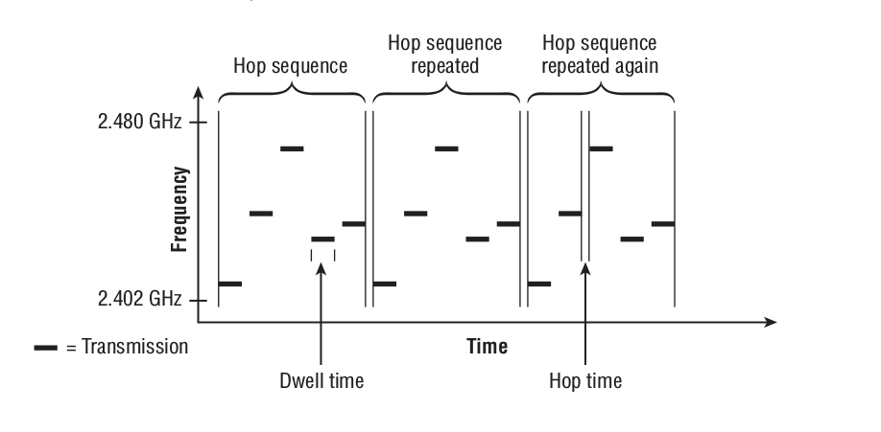
802.11 FHSS PHY

Slide 12
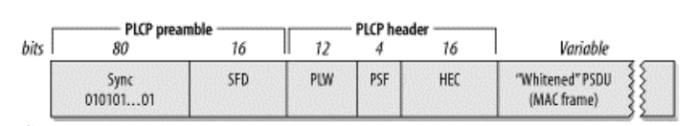
802.11 FHSS PHY
Sync: To alert the receiver that the potentially receivable signal is present.
Start Frame Delimiter: Consists of 16 bit as 0000 1100 1011 1101
PSDU Length Word(PLW): The 12-bit length field informs the receiver of the length of the MAC frame that follows the PLCP header
PLCP signaling(PSF): bit 0 is reserved, bit 1-3 encode the speed at which the payload MAC frame is trasmitted.
Header Error Check(HEC)

Slide 13
802.11 DSSS PHY
DSSS provides 1 and 2 Mbps RF communications using the 2.4 GHz ISM band.
The data that is being transmitted is spread across the range of frequencies that make up the channel. The process of spreading the data across the channel is known as data encoding.
The system converts the 1 bit of data into a series of bits that are referred to as chips.
To create the chips, a Boolean XOR is performed on the data bit and a fixed-length bit sequence pseudo random number (PN) code. Using a PN code known as the Barker code.
Binary data 1 = 1 0 1 1 0 1 1 1 0 0 0
Binary data 0 = 0 1 0 0 1 0 0 0 1 1 1

Slide 14
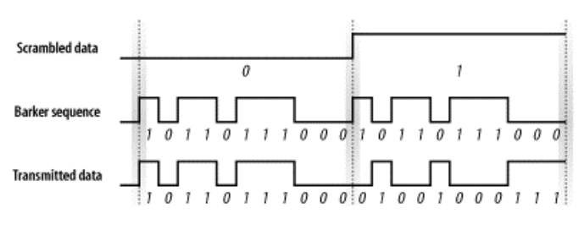
802.11 DSSS PHY

Slide 15
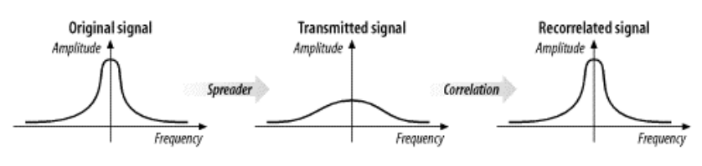
802.11 DSSS PHY
Although 1 bit of data might need only 2 MHz of frequency space, the 11 chips will require 22 MHz of frequency carrier space.
This process of converting a single data bit into a sequence is often called spreading or chipping.

Slide 16
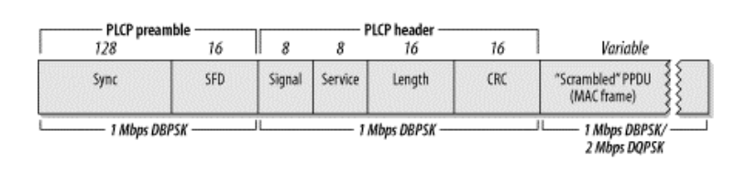
802.11 DSSS PHY
Sync: 128 bits as 11111...1
SFD: 16 bits as 0000 0101 1100 1111
Signal: 8 bits for identify the transmission rate.
Service: Reserved as 0's.
Length: To set the no.of microseconds required to transmit the frame.
CRC: To protect the against corruption.

Slide 17
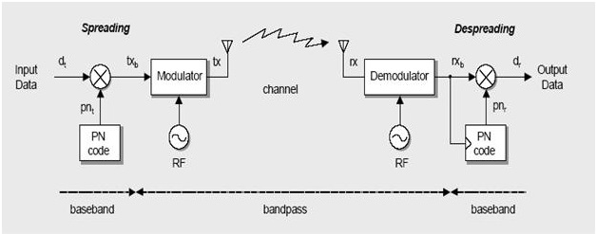
802.11 DSSS PHY

Slide 18
802.11b HR - DSSS PHY
HR DSSS provides 1 Mbps, 2Mbps, 5.5Mbps and 11 Mbps RF communications using the 2.4 GHz ISM band.
The 802.11b 5.5 and 11 Mbps speeds are known as High-Rate DSSS (HR-DSSS).
To help provide the faster speeds of HR-DSSS, a more complex code, Complementary Code Keying (CCK) is used.
CCK uses an eight-chip pseudorandom number (PN), along with using different PNs for different bit sequences.
CCK can encode 4 bits of data with 8 chips (5.5 Mbps) and can encode 8 bits of data with 8 chips (11 Mbps).

Slide 19
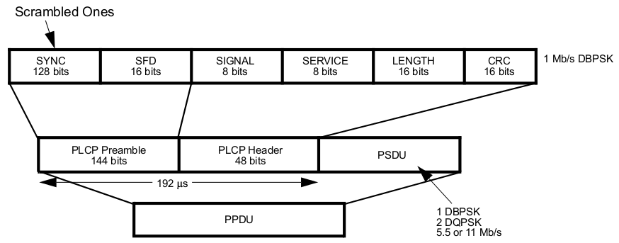
802.11b HR - DSSS PHY

Slide 20
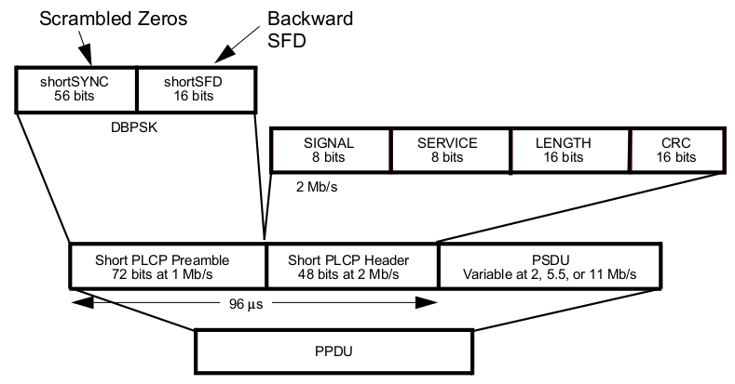
802.11b HR - DSSS PHY

Slide 21
802.11b HR - DSSS PHY
Sync
  For Long PLCP preamble → 128 bits (1111......1)
  For short PLCP preamble → 56 bits (0000......0)
SFD
  For Long PLCP preamble → 16 bits (1111 0011 1010 0000)
  For short PLCP preamble → 16 bits (0000 0101 1100 1111)
Signal (8 bits)
  For Long PLCP preamble → 0x0A - 1 Mbps; 0x14 - 2 Mbps; 0x37 - 5.5 Mbps; 0x6E - 11 Mbps
  For short PLCP preamble → 2 Mbps, 5.5 Mbps, & 11 Mbps
Service
  For Both PLCP Preamble → b2 - Clock lock, b3– Modulation(0=CCK, 1=PBCC), b7– Length Extension bit

Slide 22
OFDM
In 1999, 802.11a is based on orthogonal frequency division multiplexing (OFDM).
The OFDM system provides a WLAN with data payload communication capabilities of 6, 9, 12, 18, 24, 36,48, and 54 Mb/s.
The system uses 52 subcarriers that are modulated using binary or quadrature phase shift keying (BPSK or QPSK) or using 16- or 64-quadrature amplitude modulation (16-QAM or 64-QAM) .
Forward error correction coding (convolutional coding) is used with a coding rate of 1/2, 2/3, or 3/4.

Slide 23
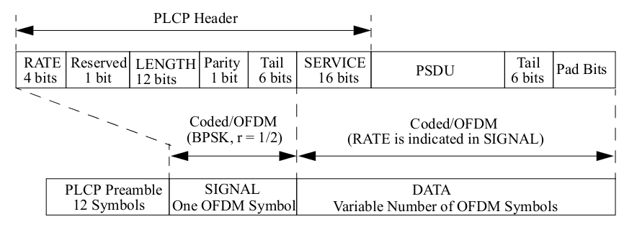
OFDM – PLCP sublayer

Slide 24
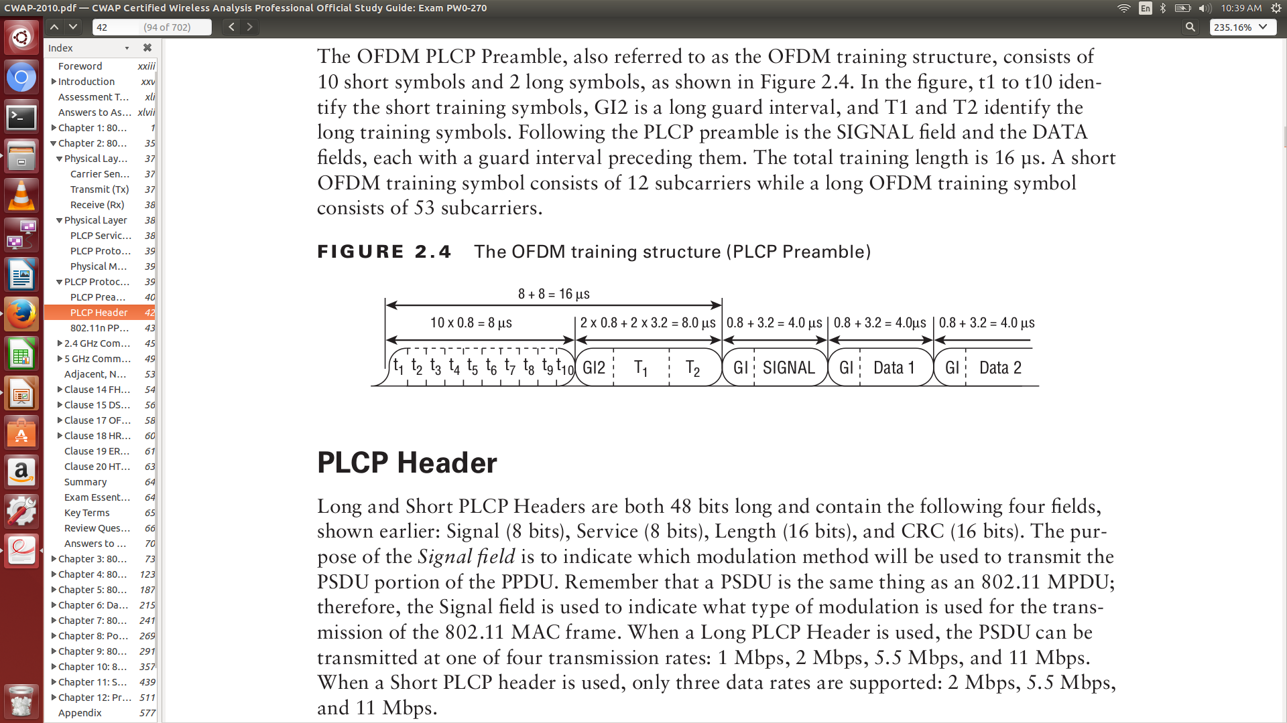
OFDM – PLCP sublayer
Short OFDM training sequences
Long OFDM training sequences

Slide 25
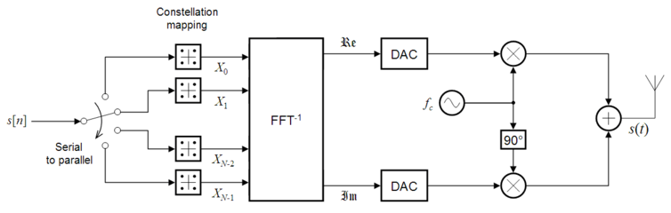
OFDM – PMD sublayer
Transmitter

Slide 26
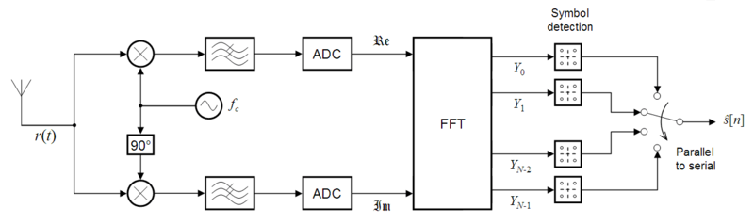
OFDM – PMD sublayer
Receiver

Slide 27
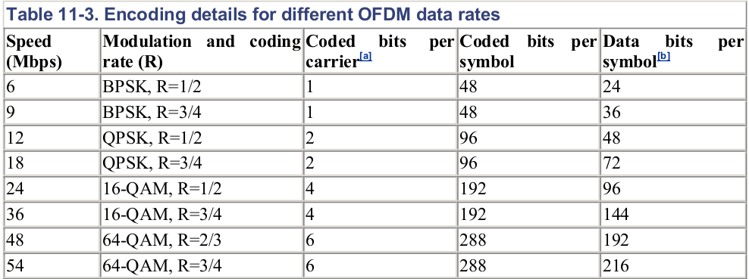
OFDM – PMD sublayer
BITS
(4 bits)
1101
1111
0101
0111
1001
1011
0001
0011

Slide 28
802.11n HT PHY
802.11n-2009 amendment was to increase the data rates and the throughput in both the 2.4 GHz and 5 GHz frequency bands.
The 802.11n amendment defines a new operation known as high throughput (HT), which provides PHY and MAC enhancements to provide for data rates potentially as high as 600 Mbps.
802.11n radios use multiple-input multiple-output (MIMO) with OFDM technology.
The HT PHY data subcarriers are modulated using BPSK, or QPSK, or 16-QAM, or 64-QAM.
Forward error correction (FEC) coding (convolutional coding) is used with a coding rate of 1/2, 2/3, 3/4, or 5/6. LDPC codes are added as an optional feature.
The maximum HT PSDU length is 65 535 octets.

Slide 29
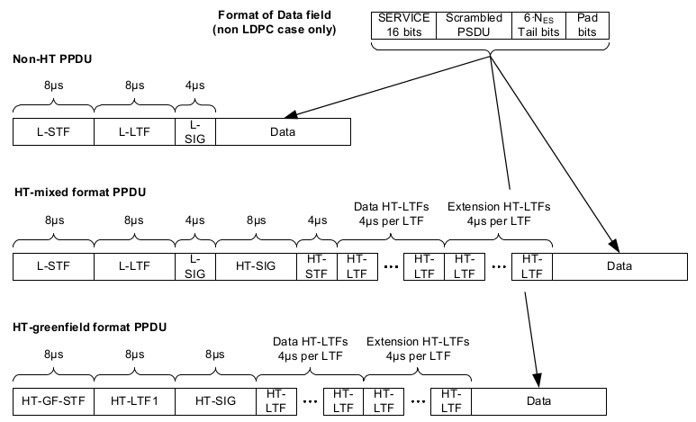
802.11n HT PHY

Slide 30
802.11n HT PHY
PPDU Format
Non-HT format (NON HT)
HT-mixed format (HT MF)
HT-greenfield format (HT GF)

Slide 31
2.4 GHz Channels
The 2.4 GHz spectrum for 802.11 usage is only 83 MHz, from 2.400 GHz to 2.483 GHz.
Total of 14 channels defined for use by Wi-Fi 802.11 for the 2.4 GHz ISM band.
WLAN / Wi-Fi channels are spaced 5 MHz apart. Each channel is either 22 MHz wide or 20 MHz wide based upon modulation type.
Various non-802.11 devices also operates in this frequency range causing interference for Wi-Fi devices.

Slide 32
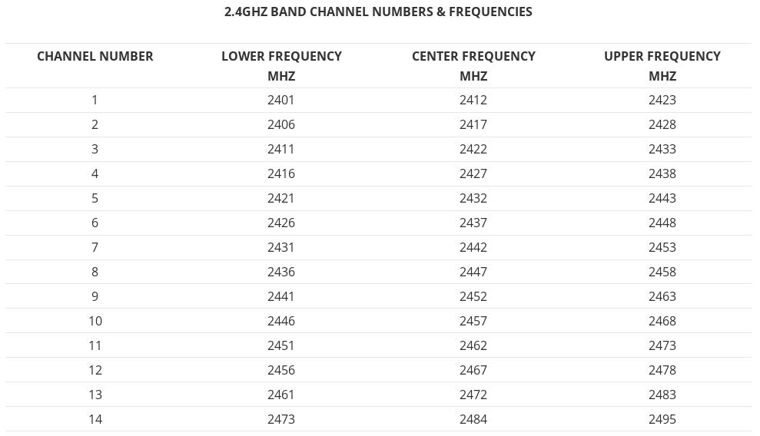
2.4 GHz Channels

Slide 33
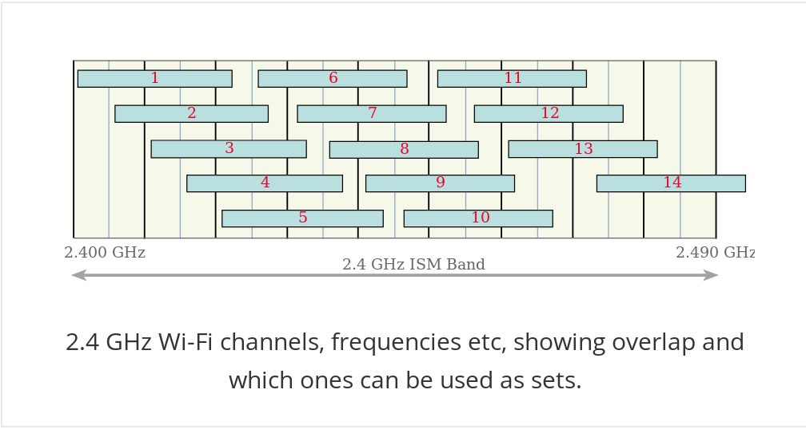
2.4 GHz Channels
2.4 GHz Wi-Fi channel overlap and selection
Channels overlap and it is possible to find a maximum of three non-overlapping channels.
There are five combinations of available non overlapping channels.

Slide 34
5 GHz Channels
OFDM channels are approximately 20 MHz wide.
There are 23 channels in this range, Channels increment by 4 starting with channel 36.
Multiple Bands for use
  UNII 1 → 5.15 GHz to 5.25 GHz → 36, 40, 44, 48 channels (4) → 5.18, 5.20, 5.22, 5.24 center freq.
  UNII 2 → 5.25 GHz to 5.35 GHz → 52, 56, 60, 64 channels (4) → 5.26, 5.28, 5.30, 5.32 center freq.
  UNII 3 → 5.725 GHz to 5.825 GHz → 100,104, … 140 channels (11) → 5.50, 5.52, … 5.70 center freq.
  UNII 2 Extended → 5.470 GHz to 5.725 GHz →149, 153, 157, 161 channels (4) → 5.745, ... 5.805 center freq.
The 5 GHz spectrum has more non-overlapping channels available.
Dynamic Frequency Selection (DFS) required for use in certain regions to utilize some channels.

Slide 35
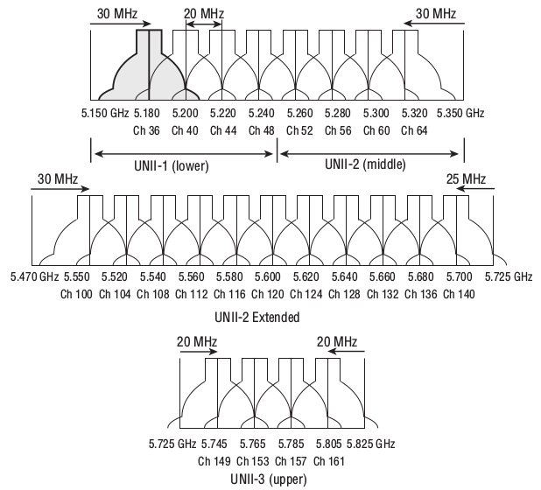
5 GHz Channels

